Slide 1


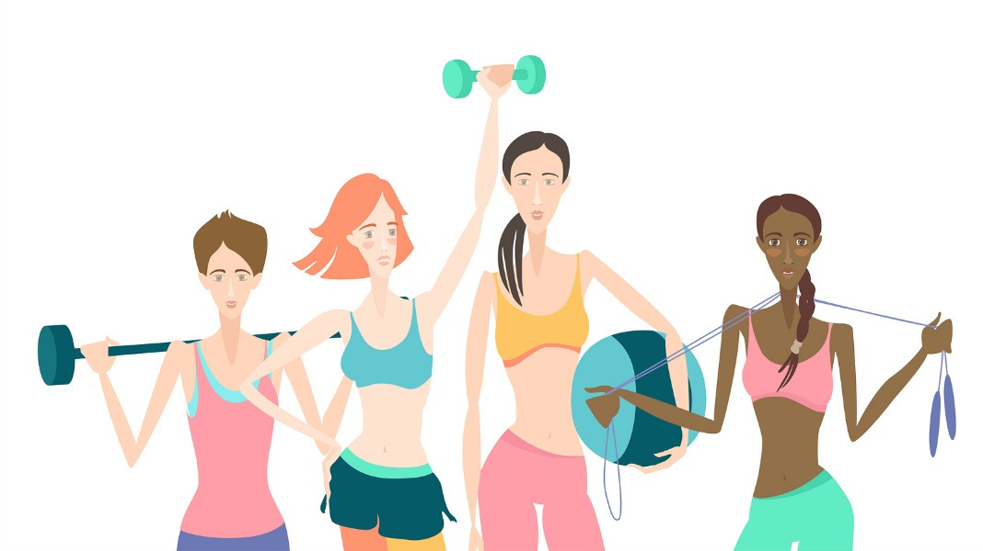
How Can a Wellness Technology Company Play It Smart?
By: Angel Zapata
April 2023
A Google Data Analytics Capstone Project

Slide 2

Business Task
Bellabeat was founded in 2013 and has grown very rapidly. It was quickly positioned as a tech-driven wellness company for women.
Analyze smart device usage data in order to gain insights into how consumers use non-Bellabeat smart devices

Slide 3
Analytical Goals
WHY: Make informed decisions for the future of their products and marketing strategy.
HOW: Provide Bellabeat's executive team with high-level recommendations on how these trends can shape their marketing strategy.

Slide 4
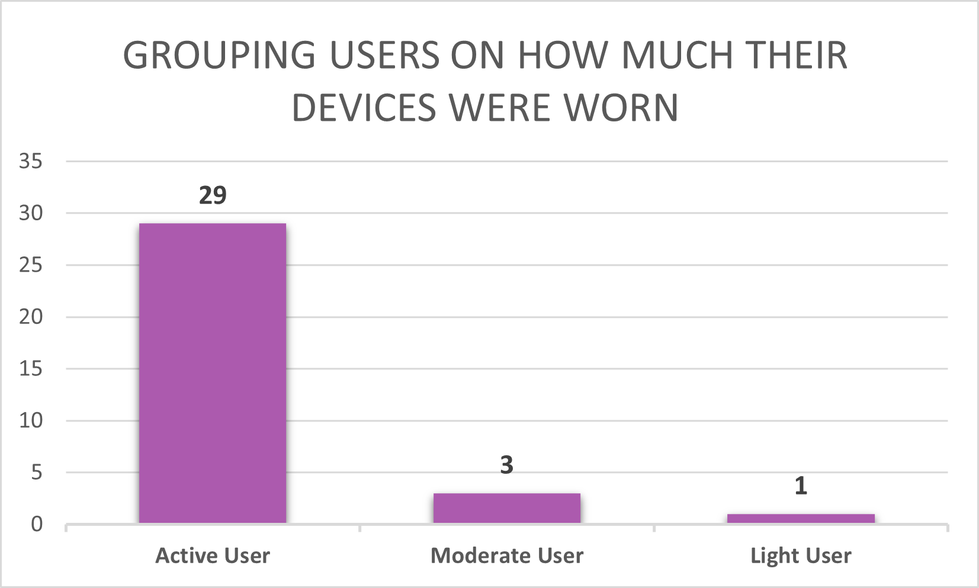
MORE DATA IS NEEDED FOR A COMPLETE ANALYSIS
Active users wore their trackers for 25-31 days
Moderate users wore their trackers for 15-24 days
Light users wore their trackers for 0-14 days
Only 21 users strictly wore their devices for the 31 days

Slide 5
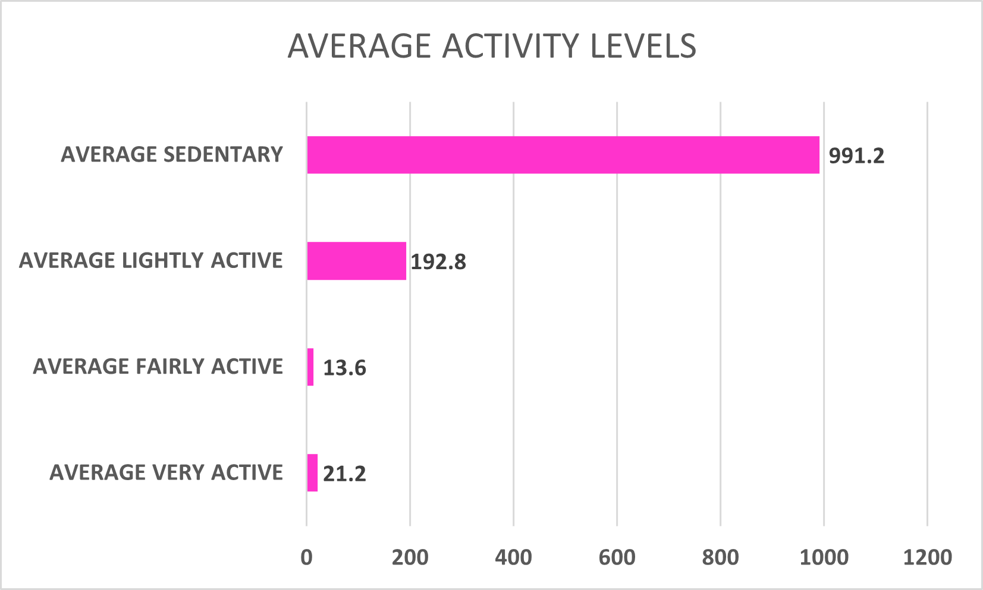
WHAT WAS THE USERS’ LEVEL OF PHYSICAL ACTIVITY?
On average, users spent the greatest number of minutes in the Sedentary Activity level

Slide 6
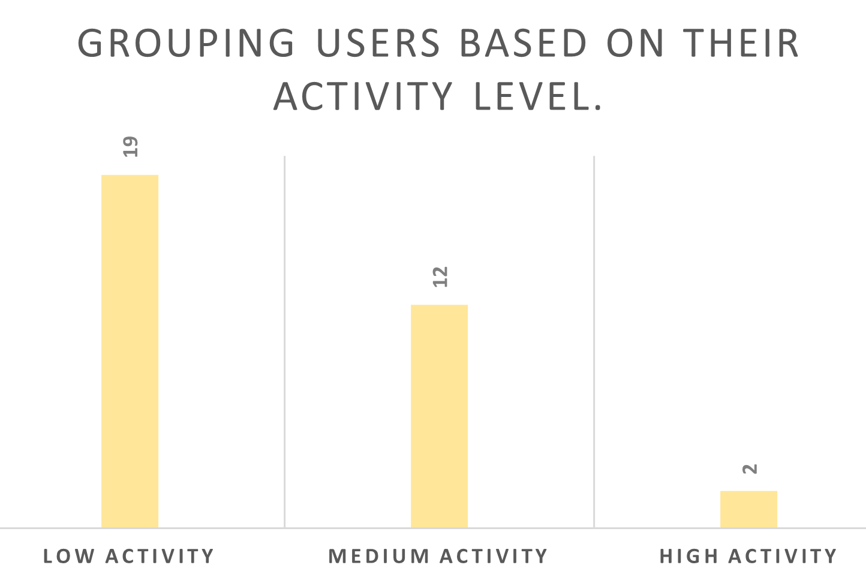
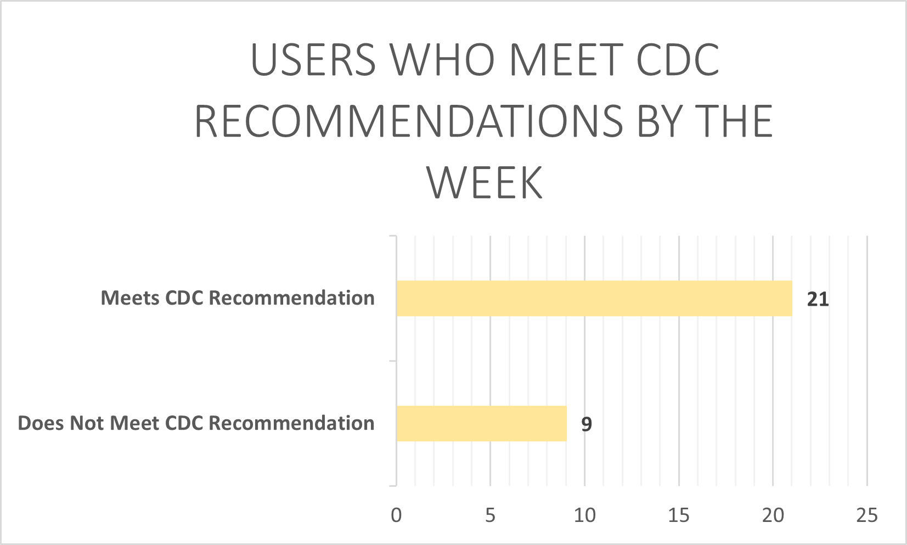
WERE OUR USERS MEETING RECOMMENDATIONS FROM THE CDC?
Low Activity: 0-50 minutes.
Medium Activity: 51-100 minutes.
High Activity: 101-150 minutes.
The CDC recommends 150 minutes of moderate-intensity physical activity

Slide 7
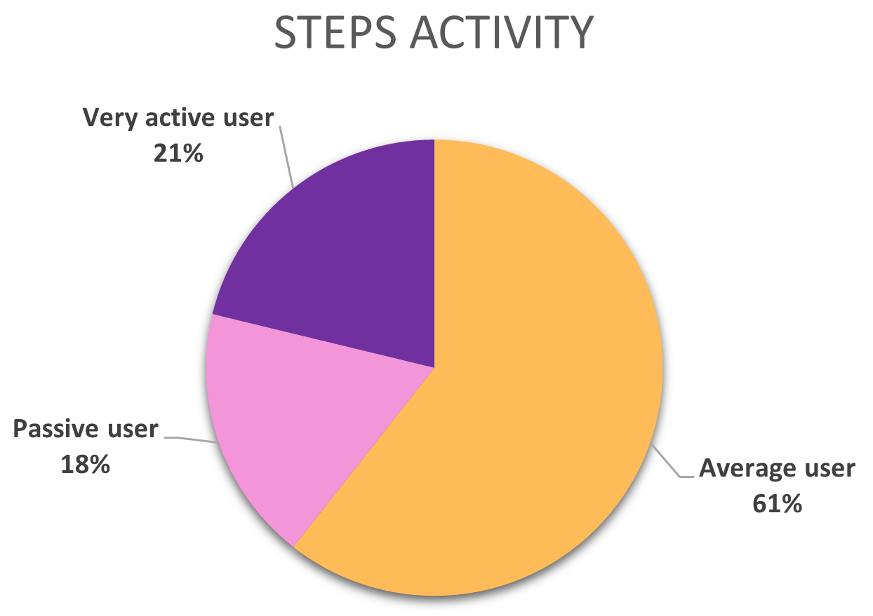
STEP ACTIVITY
Were users achieving the recommended daily goal of taking 10,000 steps per day?
The Mayo Clinic published this article suggesting that individuals should aim to take 10,000 steps per day.
Passive users: 0 - 4,500 steps
Average users: 5,501 - 9,500 steps
Very active: 9,500 + steps

Slide 8
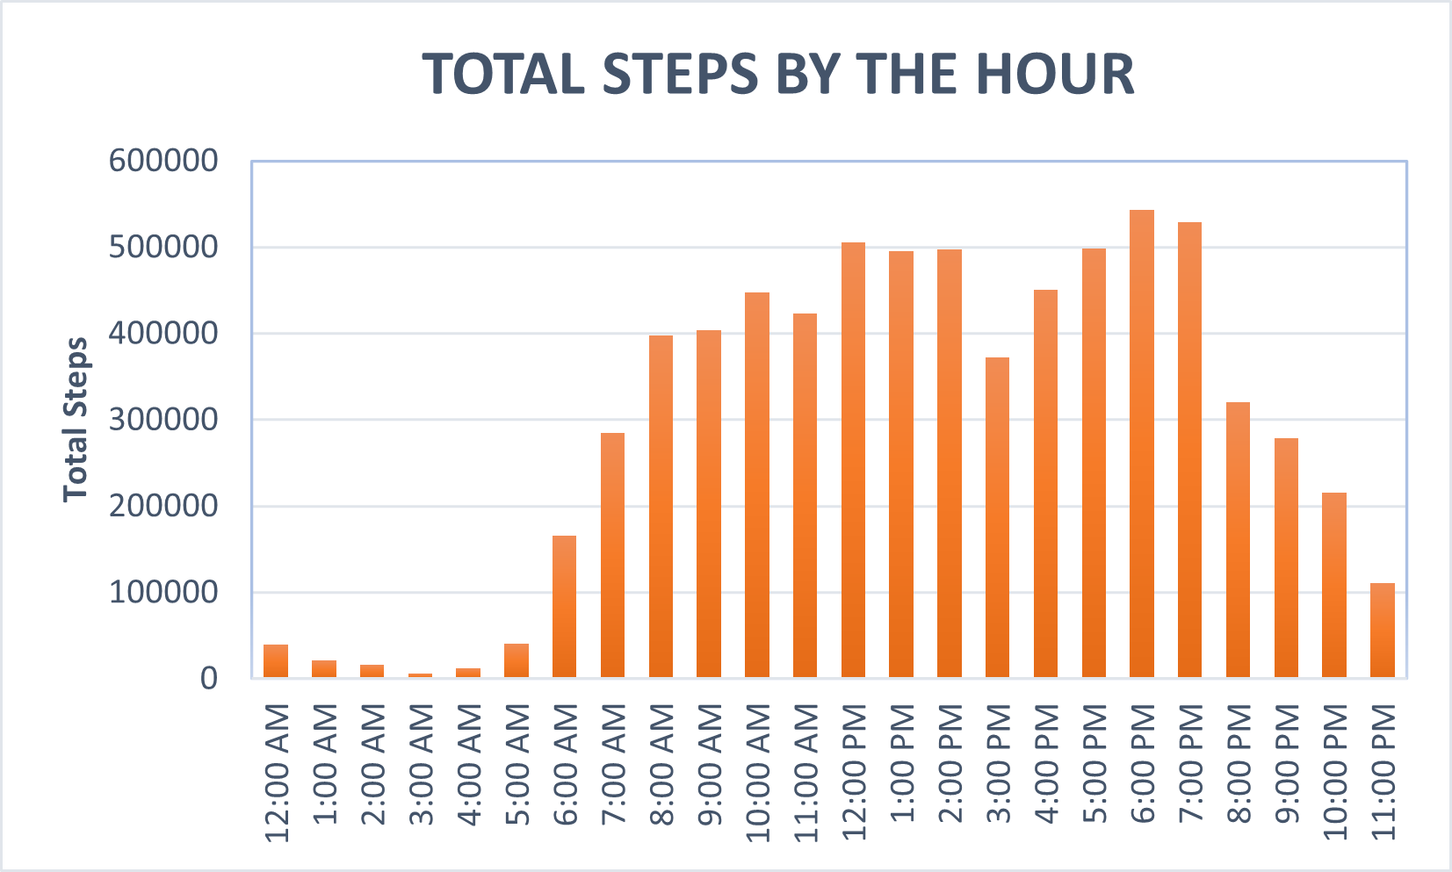
STEP ACTIVITY
Were users achieving the recommended daily goal of taking 10,000 steps per day?
The Mayo Clinic published this article suggesting that individuals should aim to take 10,000 steps per day.
The busiest hours were in the afternoon (12:00pm to 2:00pm) and evening hours (5:00pm to 7:00pm).

Slide 9
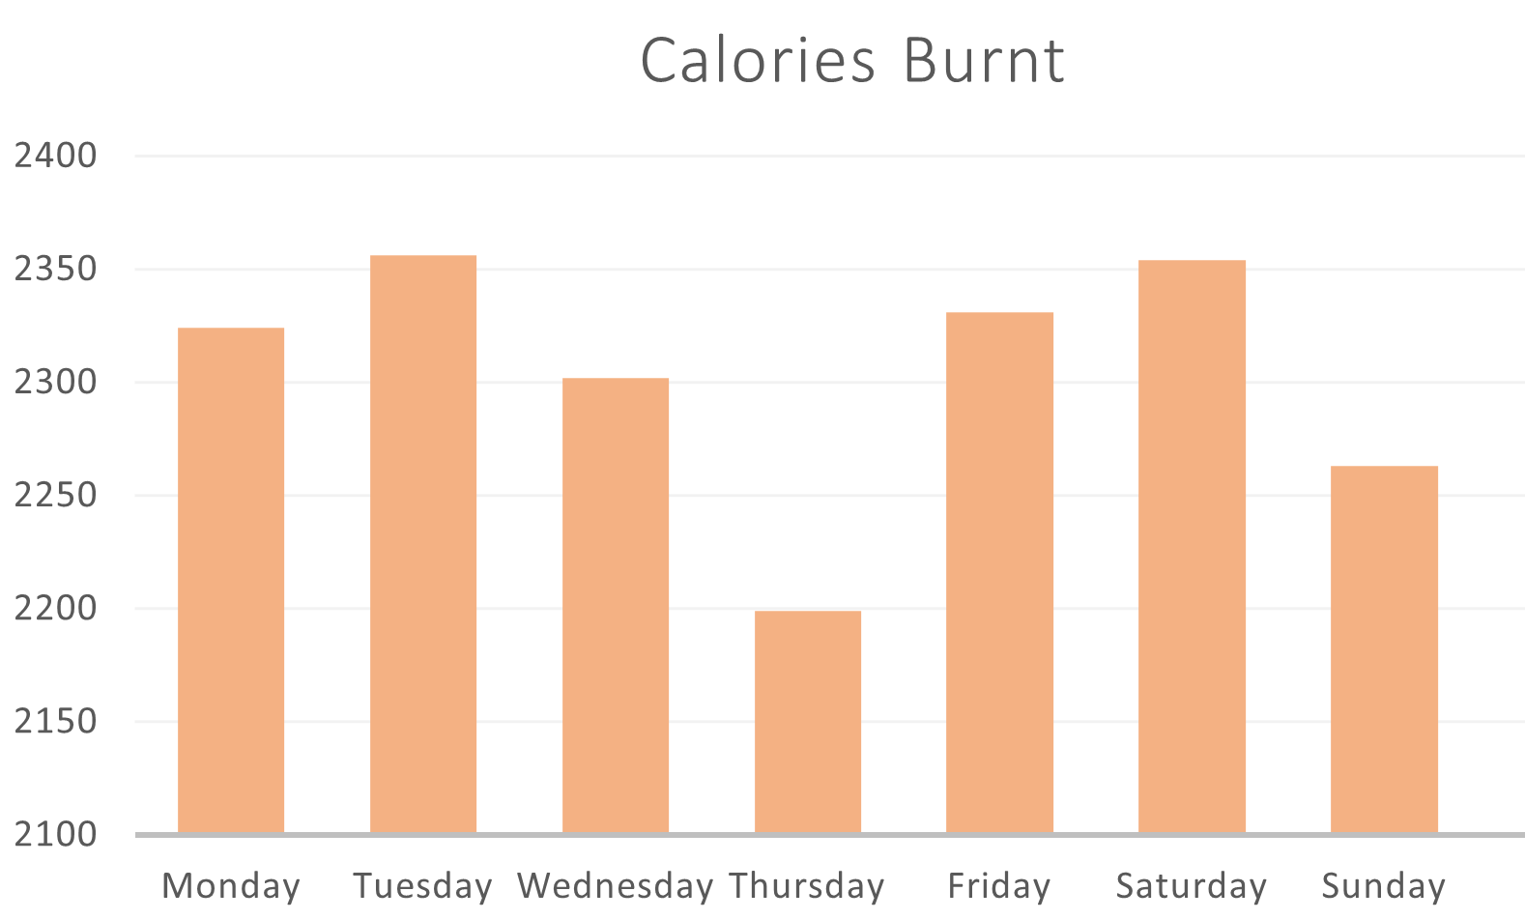
HOW MANY CALORIES DID THE USERS BURN?
Thursdays and Sundays had the lowest calories burnt averages

Slide 10
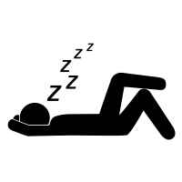
TRACKING SLEEP
How many users were meeting the 7 - 9 hours of daily sleep?
Only 20 users, on average, were getting enough daily sleep.
13 users were not getting enough sleep. That's 41% of our users.

Slide 11

RECOMMENDATIONS
Bellabeat should actively encourage user engagement with their devices to ensure precise tracking of individuals' overall health behaviors.
1. Offer rewards that can be redeemed for merchandise, discounts on future products, or in-app features.
2. Implement in-app challenges among friends and users in the same city/state to encourage continuous tracking.
3. Provide additional incentives on specific days when people tend to lose interest or motivation in exercising.

Slide 12
RECOMMENDATIONS
Given that a lot users struggled to get more than 7 hours of sleep, Bellabeat should implement features to help their customers get their recommended sleep time.
1. Notifications to alert users when it's time to start getting ready for bed.
2. Send reminders to users to disable blue light on their phones at least two hours before bedtime.

Slide 13
RECOMMENDATIONS
Bellabeat products should include features for calculating BMR (Basal Metabolic Rate) and other health-related measurements.
1. Allows consumers to input their sex, age, weight, height, and other relevant information to obtain accurate results.
2. Provides users with information on their maintenance calories and the daily caloric deficit.
3. Users could receive notifications when they reach or exceed their daily caloric intake.
4. Incorporate articles, videos, and lists of activities that promote transitioning from sedentary to light physical activities.

Slide 14
THANK YOU!
Contact Info:
Email: azap2124@gmail.com
Phone number: (719) 757-6664
LinkedIn: https://www.linkedin.com/in/angelzap2124/
Full case study: https://github.com/azap2124/bellabeat_case_study

